Slide 1
Reflexes
A rapid, automatic response to a change in the external or internal environment

Slide 2
Properties of a reflex:
Stimulus is required to trigger – not spontaneous
Involuntary – occurs without conscious thought
Response is rapid – only a small number of neurons involved
Response is stereotyped – impulses travel the same way each time it happens

Slide 3
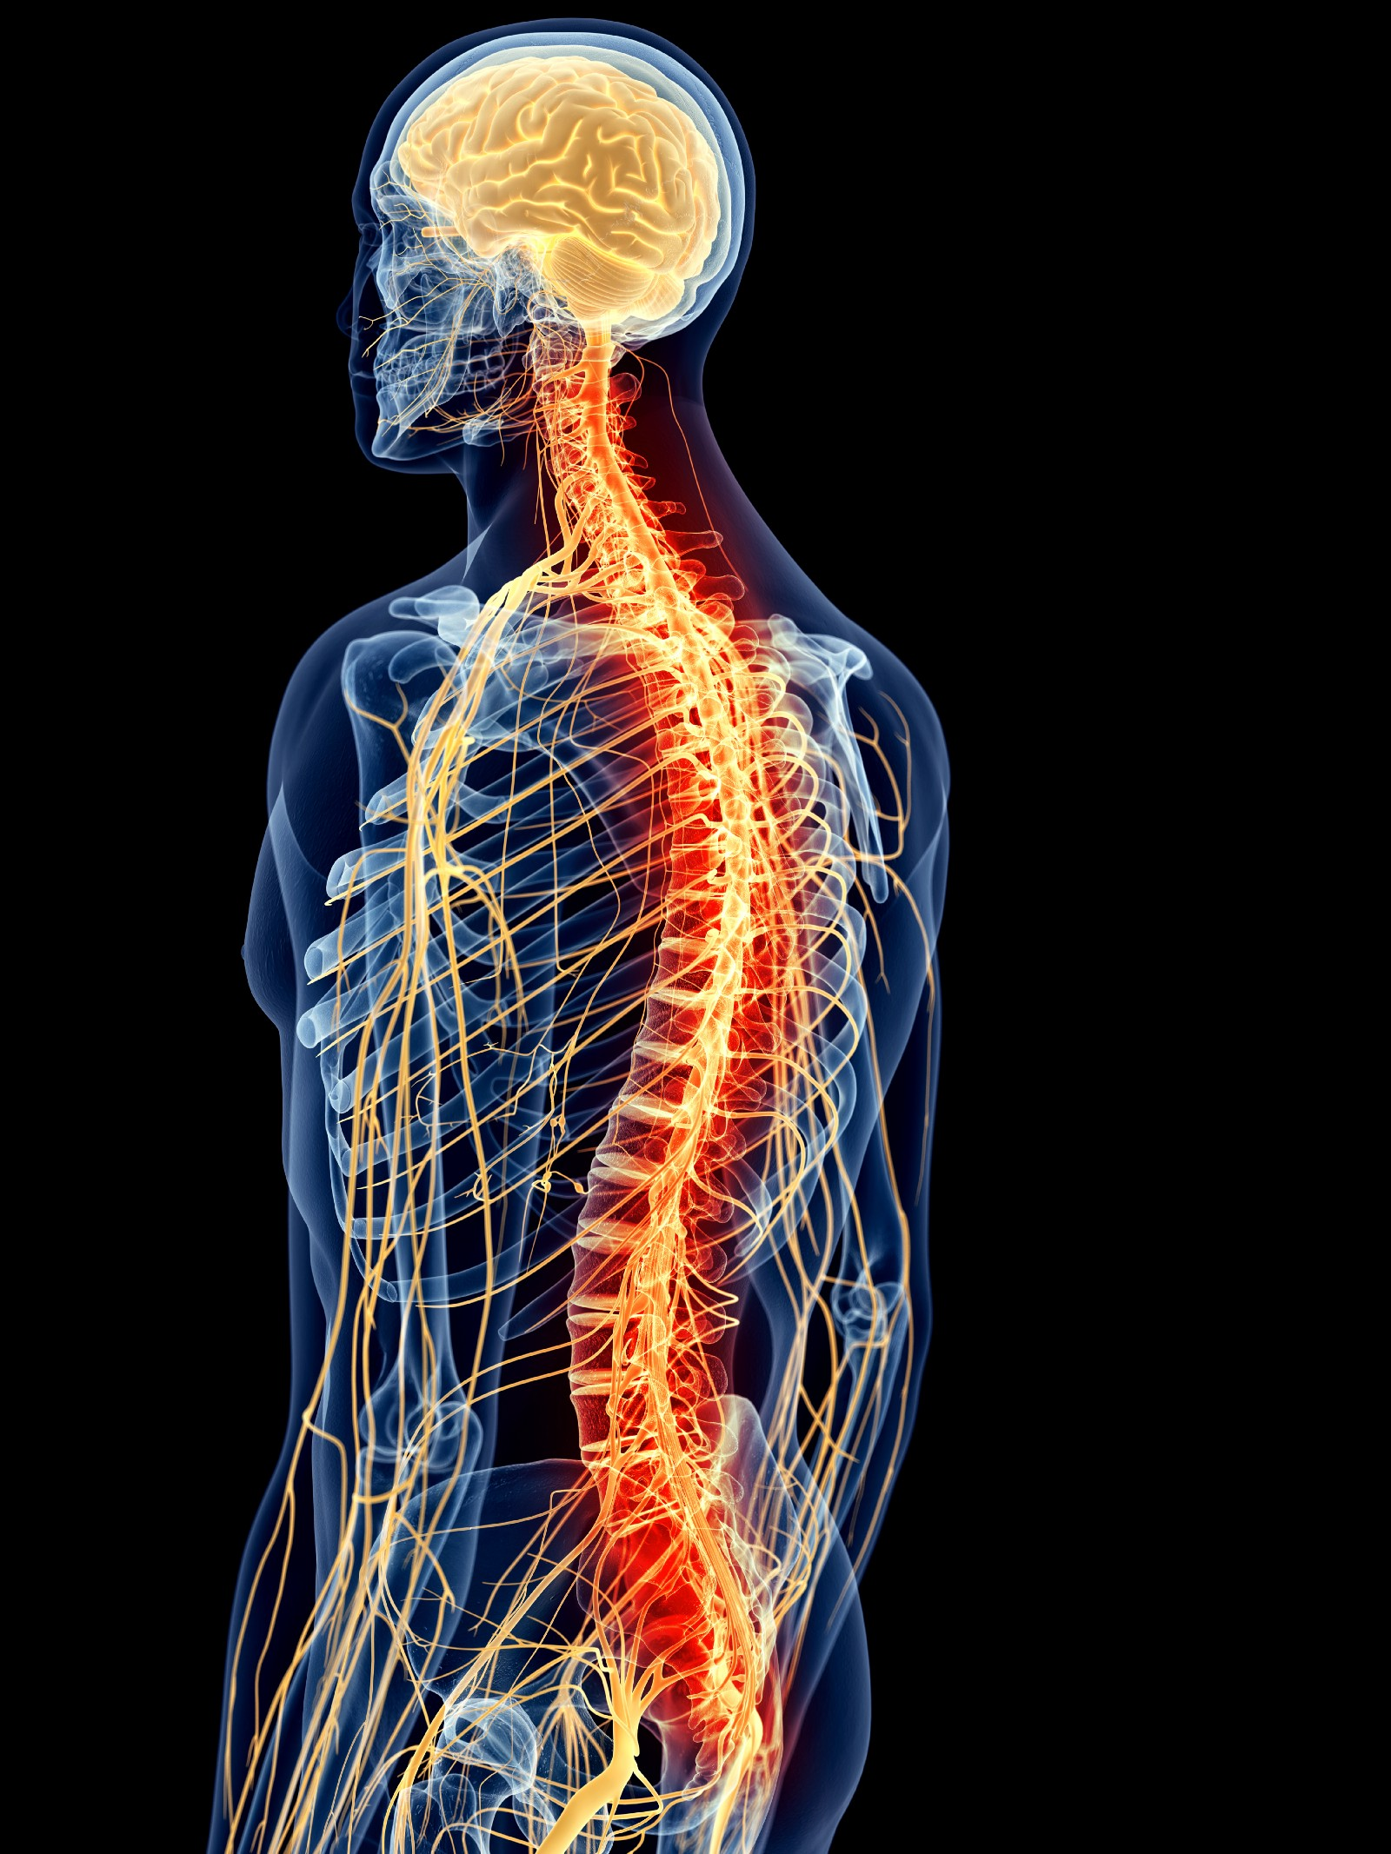
(Spinal) Reflex arc
Pathway a nerve impulse travels from a receptor to an effector
Most are coordinated in the spinal cord (some in the unconscious parts of the brain)
Involuntary (even though contraction of skeletal muscles may occur)
Conscious awareness occurs after the response has been initiated

Slide 4
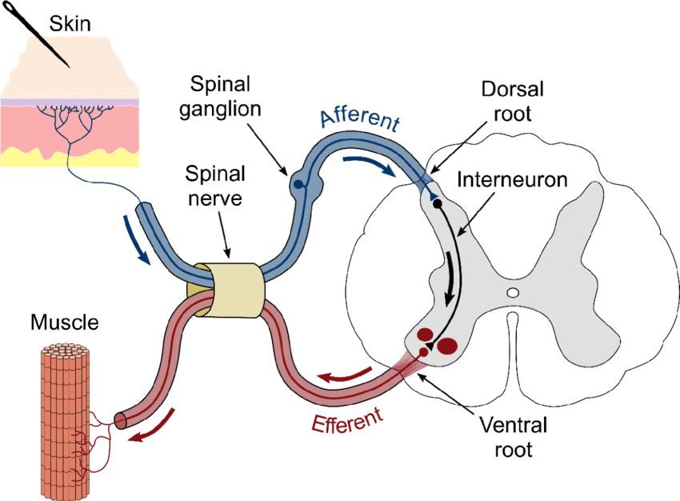
Components of a reflex arc
A receptor
Ending of a sensory neuron or specialised cell associated with end of sensory neuron
Stimulated by ∆ internal/external environment
initiates a nerve impulse
Sensory neuron
Carries impulse into the CNS (brain/spinal cord)

Slide 5
Components of a reflex arc (continued)
Synapse
Can be passed directly to motor neuron or one or more interneurons
Interneurons direct the impulse to the correct motor neuron
Motor neuron
Carries the nerve impulse to an effector
Effector
Carries out appropriate response
Muscle cells or secretory cells

Slide 6
Examples of reflexes
Secretion of saliva in response to sight, smell, and taste of food

Slide 7
Learned reflexes
Innate reflexes - complex motor patterns appear during development
Determined genetically
Suckling
Chewing
Following movements with their eyes
Acquired reflexes – through constant repetition
Muscular adjustments required for bike riding
Jamming the brakes of a car
Catching a ball

